Slide 1
Annual Report
2020 - 2021
QA&IE Unit

Slide 2
Data Accessibility
Key Performance Indicators
Policies and Procedures
Faculty Development Sessions
Community Engagement Events
Research Seminars
Career Counseling Sessions
Extra-curricular Activities
Meeting Minutes

Slide 3
Data Accessibility
Document Bank
Colleges
Department Manuals
University-Level Surveys
Terms of Reference
Strategic Plan and Operational Reports
Programs
Course Evaluation
Exit Survey
University Services Survey
University-Level Documents
Job Description
MOUs

Slide 4
International Accreditation
QAA accreditation: GRANTED
Extract from the QAA Report
“Good practice
The QAA review team identified the following features of good practice at Gulf Medical University
The effective use made of external examiners, and externality more broadly, in assuring assessment standards and external benchmarking. (Standard 1.3 & 1.9)
The multiple opportunities for students to provide feedback has positively impacted on their overall learning experience. (Standard 1.7)
The Quality Assurance and Institutional Effectiveness portal, which provides staff at all levels easy access to data and information critical to monitoring many aspects that impact on student progression, achievement and evaluation of programme effectiveness. (Standard 1.7, 1.9, 1.10)”

Slide 5
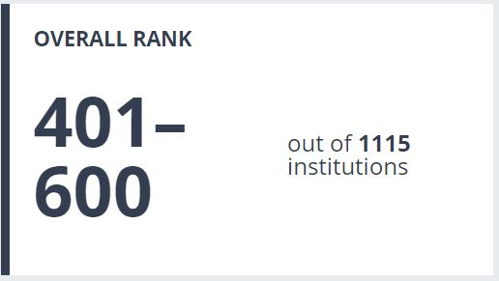
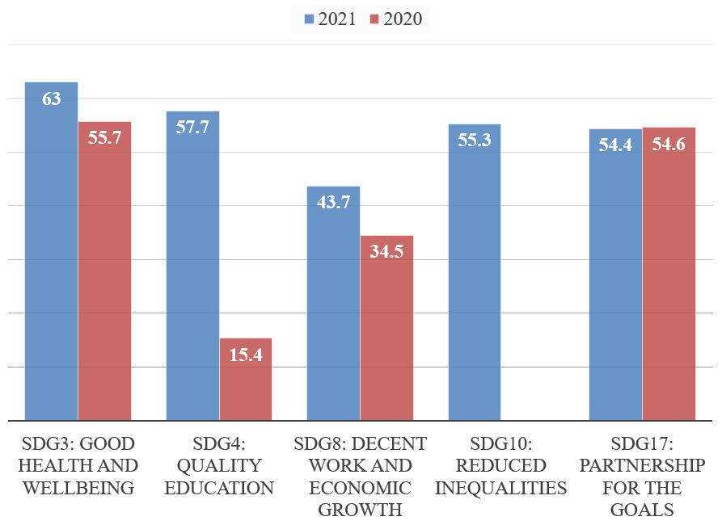
Impact Ranking – Times Higher Education
401-600 worldwide in the 2021 THE Impact Ranking.
The ranking includes 1115 Universities from 98 countries all over the world.
Last year: 600+ out of 768
Reasons for Improvement:
1- Applying for SDG 10 for the 1st time.
2- Understanding the questions in a better way before submission.
3- Making changes in our policies and website to address THE requirements.

Slide 6

QS STARS
QS stars rating system was stopped in October 2021.
Reasons:
Reputation of this rating system is not satisfactory.
Lack of fairness: GMU was deprived from the regional (Arab) ranking due to being a specialized (medical) university although similar cases was found in Asia and South America.
Impact
This saved 41,000 USD and allowed the University to re-allocate this budget for more useful projects.

Slide 7
Supporting National Accreditation
Initial accreditation of 1 program
Reaccreditation of 2 programs
SSRs submitted for re-accreditation of 8 programs
The deadline for re-accreditation of each program along with the latest accreditation letters are available on: http://www.iru-gmu.com/accreditation-status.html

Slide 8

University Website (Updated to Fulfill Annex 22 OF THE caa Standards)
GMU website was updated to fulfill Annex 22 of the CAA standards at both institutional and program levels.

Slide 9
Feedback on Career Counseling Sessions
The QA&IE Unit collected feedback on 48 career counseling sessions conducted throughout the academic year across all colleges.
Quotes from student feedback:
“I am grateful to the university for arranging this session, for I have no medical background and I need guidance. This type of sessions do give some insights which is what makes me attend these sessions.”
“I was really impressed that the speaker had the full amount of information that she answered every single question that was asked for her, I also liked the fact that she was really friendly and eager to give all the info we needed despite how long the answer can be.”

Slide 10
Policies and Procedures (36 new policies)
Organization
Terms of Reference of Standing Committees
Policies Development, Document Control, Review and Dissemination
Risk Management
Internal Communications
External Communications
Program Planning and Development
Program Specifications
Course Substitution
E-Learning
Additional Degree from the same Institution
Teaching and Learning Methodologies
Course Syllabus
Academic Misconduct
Research Support
Ethical Research
Student Involvement in Research
Commercialization of Research Output
Publication Fees coverage
Internal Research Grant
Anti-Nepotism
Degree Audit
Grade Approval and Change
Student Attendance
Gender Segregation
Student Council
Alumni Relations
Equipment and Software Replacement
Data Security
Equipment and Software Technical Support
Internal Audit
Anti-Corruption and Bribery
Co-operative Arrangements and Contractual Relationships
Website
Advisory Board and Advisory Committees
Continuous Education and Lifelong Learning

Slide 11
Policies and Procedures
(18 Revised Policies)
Standard 3: Educational Program
GMU-POL-S03-011 Grading and Assessment
GMU-POL-S03-015 Teaching and Learning Methodologies
GMU-POL-S03-016 Course Syllabus
GMU-POL-S03-017 Course File
GMU-POL-S03-019 Regular and Intensive Modes of Course Delivery
GMU-POL-S03-021 Substantive Change
Standard 5: Faculty & Professional Staff
GMU-POL-S05-015 Recruitment
GMU-POL-S05-007 Faculty Workload
GMU-POL-S05-008 Professional Requirements for Teaching
GMU-POL-S05-009 Faculty and Staff Evaluation
Standard 6: Students
GMU-POL-S06-001 Undergraduate Admissions
GMU-POL-S06-002 Graduate Admissions
GMU-POL-S06-003.1 Admission for People of Determination
GMU-POL-S06-006 Student Records
GMU-POL-S06-024 Student Grievances
Standard 11: Community Engagement
GMU-POL-S11-004-TIHWD Sponsorship Policy
GMU-POL-S11-005-TIHWD Standard Operating Procedure Policy
GMU-POL-S11-006 TIHWD Fee, Discount and Refund Policy

Slide 12
Quality Flow
End-semester QA&PE Committee
Action Plans
Course Files
Program Effectiveness Report
College Annual Report
Annual Appraisal

Slide 13
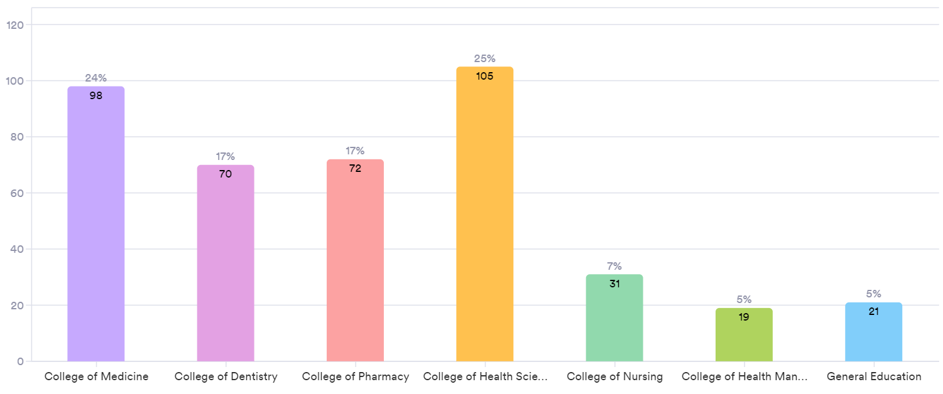
Course Files
416 course files collected from the 6 colleges and automatically shared with the College Deans, Associate Deans and QA&PE Committees for revision.

Slide 14
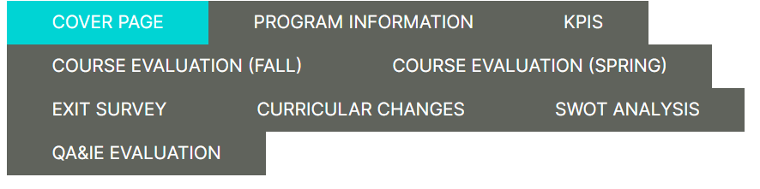
Program Effectiveness Report
21 program effectiveness reports are prepared throughout the academic year by program directors and revised by the QA&IE Unit.

Slide 15

College Annual Report
6 College annual reports are under preparation by the College Deans and Associate Deans and will be submitted by the end of July

Slide 16
Faculty Appraisal
Immediate scoring system
Automated approval pathway
Easy to revise by the department chair
Save and continue later
Filling all over the year
Editing the last year filled form to develop the current year evaluation
Re-assigning to the faculty member to edit and resubmit

Slide 17
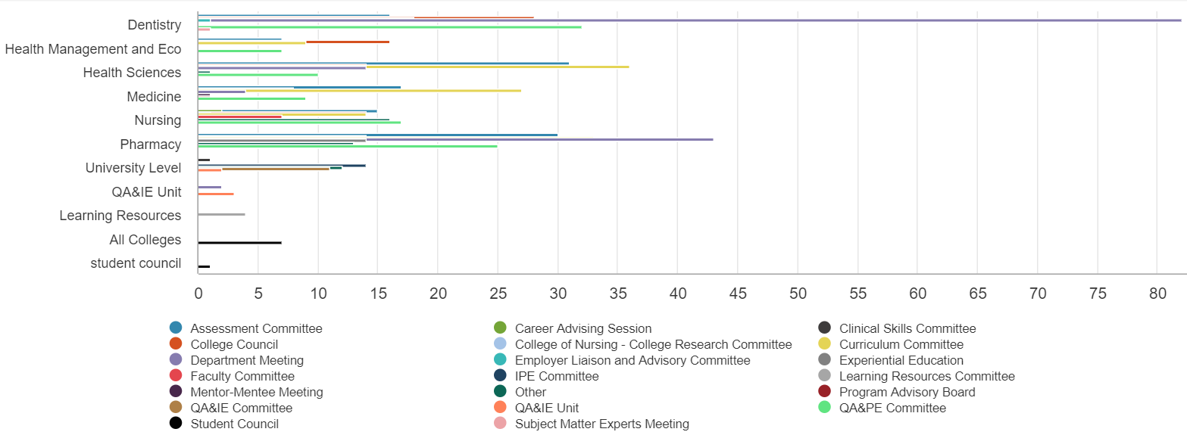
Meeting Minutes
Uniform template – Alignment of decisions to CAA standards and GMU policies – Action plan with deadline and clear responsibility assignment - (Total 761 – Randomly Checked by the QA&IE Unit)

Slide 18
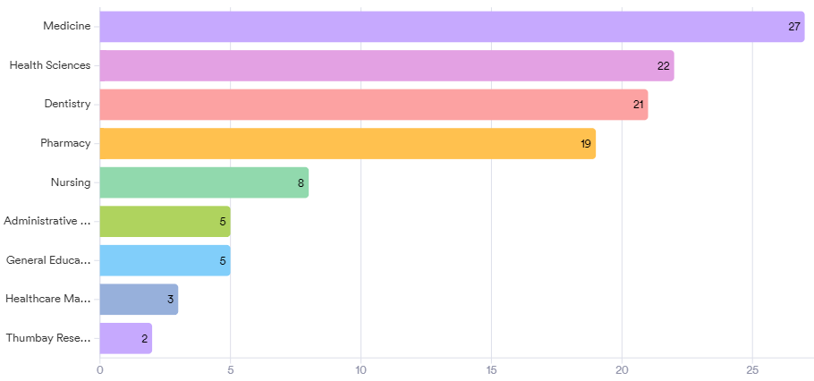
Faculty Development - Edpuzzle
Taken by 112 faculty and staff members

Slide 19
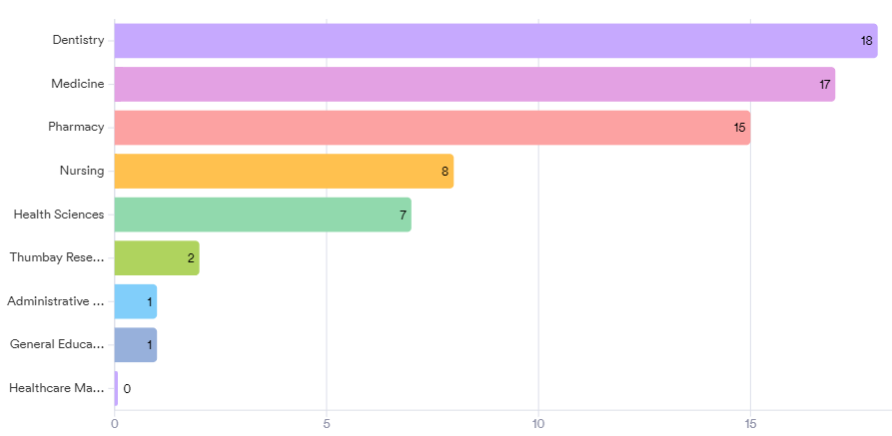
Faculty Development – Writing SSR
Taken by 69 faculty members

Slide 20
Actions Implemented in 20/21 Based on Last Year Feedback
Problem Identified Last Year | Action Taken | Current Status
More staff needed | Dr. Ibrahim was recruited in October 2020 | Addressed
Workload form is confusing | Online application is created and used by all colleges | Addressed
To improve response to Employer survey of GMU graduates | 108 responses (last time: 1 response only) | Partially addressed (more improvement needed)
Communication with colleges | The QA&IE portal was established and used by all faculty and staff | Addressed
Support to colleges in terms of training | 10 face-to-face workshops and 2 online courses have been conducted | Addressed

Slide 21
Actions Implemented in 20/21 Based on Last Year Feedback
Problem Identified Last Year | Action Taken | Current Status
Timely sharing of reports | All reports are simultaneously shared on the QA&IE portal once released | Addressed
To close the loop of quality enhancement | Program effectiveness report was established to close the loop of quality enhancement | Partially addressed (follow up on implementation needed next year)

Slide 22
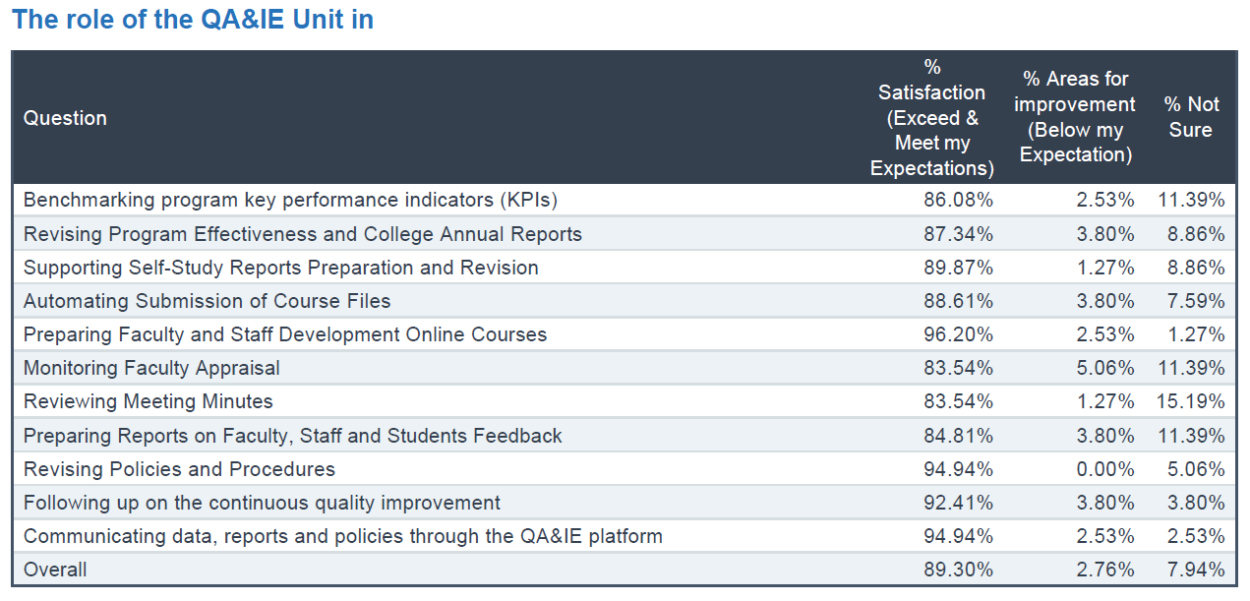
Stakeholder Evaluation of the QA&IE Unit

Slide 23
Future Plans
Area for Improvement | Pending from Last year | Action to be taken | Deadline
Job description document needs revision | No | Revising the job description document | January 2022
Terms of reference of many committees needs revision | No | Revising the terms of reference document | March 2022
Assigning close deadlines to complete tasks requested by the unit | No | Creating an annual calendar for deadlines of all tasks | September 2021
Online faculty development session needs improvement in terms of quality of embedded questions, video duration, and the time of releasing the course | No | All the suggested improvements will be considered in the coming course (Moodle) | September 2021
Revising the data before sharing with Colleges | No | Creating an online form to control and revise all data produced by the unit before sharing with Colleges | July 2021 (Done)

Slide 24
Future Plans
Area for Improvement | Pending from Last year | Action to be taken | Deadline
Benchmarking at the program level is not well developed | No | Follow-up with program directors on benchmarking at the program level | December 2021
Course files and program effectiveness report are revised by the College QA&PE committee, but this did not happen in all colleges. | No | Follow-up with College QA&PE Committee to revise course files and program effectiveness report | January 2022

