Slide 1
QA&IE REPORT
AY 21/22
Prepared by the QA&IE Team

Slide 2
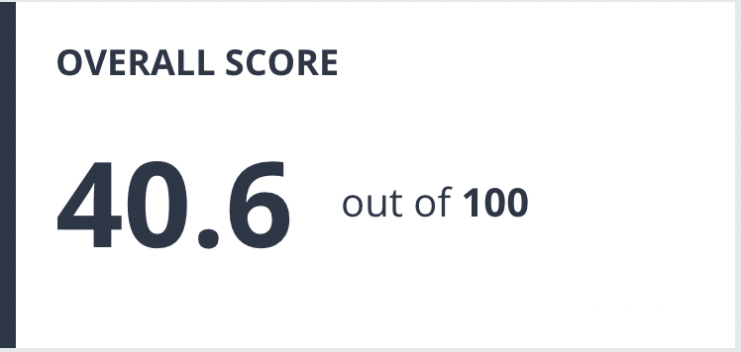
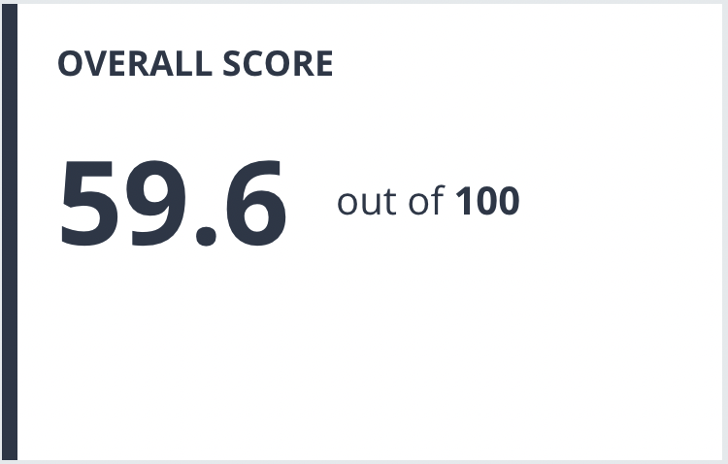
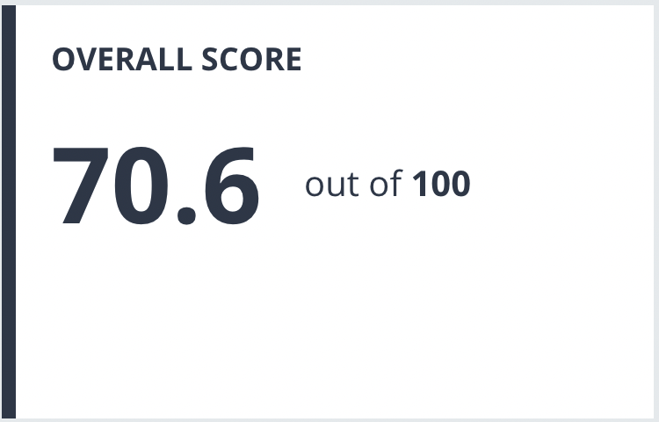
THE IMPACT RANKING
2020
2021
2022

Slide 3
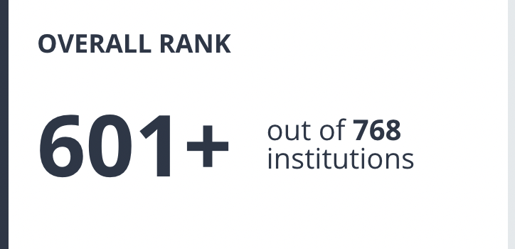
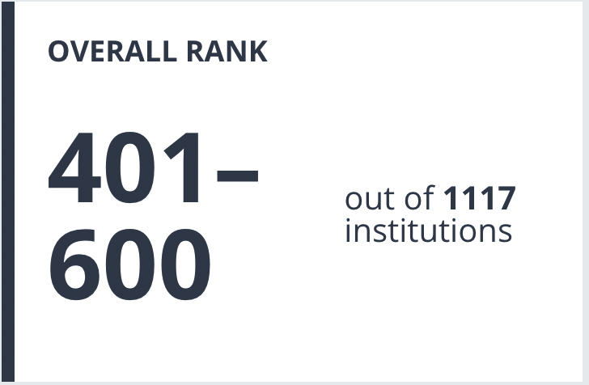
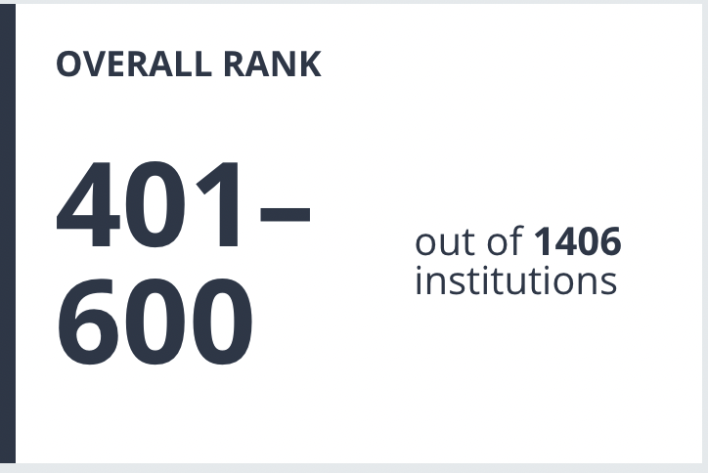
THE IMPACT RANKING
2020
2021
2022

Slide 4
CAA Re-ACCREDITATION
The QA&IE Unit supported the program directors to respond to the CAA requirements during the re-accreditation of:
Associate Degree in Pre-Clinical Sciences – COM
Masters in Health Professions Education – COM
Bachelor of Science in Nursing – CON
Bachelor of Science in Nursing for Registered Nurses – CON
Master in Clinical Pharmacy – COP
Bachelor of Science – Medical Laboratory Sciences – COHS
Bachelor of Science – Medical Imaging Sciences – COHS
Bachelor of Science - Anesthesia Technology – COHS

Slide 5
CAA Re-ACCREDITATION
The QA&IE Unit reviewed:
373 Requirements
52 Suggestions
240 Course Files

Slide 6
INTERNAL AUDIT
Master of Science in Medical Laboratory Sciences - COHS
Executive Master in Healthcare Management and Economics - COHME
Dean
Alumni
Students
Faculty
Committee Chairs
Program Director
Preceptors
Meeting with
38 Requirements
29 Requirements

Slide 7
Course files - Submission and Revision
412 Course Files
252 Submitted (61%)
179 Reviewed (43%)
In Spring 2022, the course file system:
Enable the course coordinator to build the course file within 1 hour.
Help the course coordinator to immediately submit the course file to the reviewer assigned by the respective college.
Enable the reviewer to review the course files within 15 minutes.
Enable the QA&IE unit to have real-time analytics to the submission and reivew processes.
This data is collected on July 18, 2022 at 5 pm

Slide 8
Course files - Submission and Revision
In Spring 2022, the course file system:
Enable the course coordinator to build the course file within 1 hour.
Help the course coordinator to immediately submit the course file to the reviewer assigned by the respective college.
Enable the reviewer to review the course files within 15 minutes.
Enable the QA&IE unit to have real-time analytics to the submission and reivew processes.
This data is collected on July 16, 2022 at 8 am

Slide 9
FACULTY APPRAISAL – SUBMISSION AND APPROVAL
181 FT & PT Faculty
125 Submitted (70%)
79 Approved (43%)
In the AY 21/22, the annual appraisal system Enable the QA&IE unit to have real-time analytics to the submission and approval processes.
This data is collected on July 18, 2022 at 5 pm

Slide 10
FACULTY APPRAISAL – SUBMISSION AND APPROVAL
In the AY 21/22, the annual appraisal system Enable the QA&IE unit to have real-time analytics to the submission and approval processes.
This data is collected on July 16, 2022 at 8 am

Slide 11
PROGRAM EFFECTIVENESS REPORT
College | Submission status | Information missing | Quality of the report
COM | 80% (4 out of 5 ) | One report is complete and one is almost empty, and the rest of the reports mainly missing more than one section, the KPI, Exit survey, Alumni, and college QA&PE comments | The quality varies from report to report, overall it is satisfactory
COD | 100% | The three reports are complete, one report has no comments from the college QA &PE committee | The quality of the reports was good and submitted on time
COP | 100% | 2 out of 3 are complete and one is missing many parts in the report | The completed reports have good quality
CON | 100% | The two reports are complete | The quality of the reports was good and submitted on time
COHS | 100% | The reports vary in the completeness of the information. KPIs, exit surveys, Alumni and SWOT are the main missing information in most of the reports. | The quality varies, some programs respond to the first revision comments and have remarkable improvement and some didn't
COHME | 50% (1 out of 2) | The report submitted is complete | The quality of the report is satisfactory

Slide 12
ACTION PLAN TO COMPLETE LAST YEAR PENDING SUBMISSIONS – WHAT NEXT?
Step 1:
To communicate directly with the faculty, course coordinator and/or program directors to complete course files, appraisal and/or program effectiveness report.
To copy the college Dean on all these email communications.
Step 2:
By september 15, the list of pending course files, appraisal and/or program effectiveness report will be shared with the VCA Office to have a meeting with the responsible faculty, course coordinators and/or program directors.

Slide 13
renewal of institutional Licensure
Methodology in developing SSR
Agree on the roadmap
Desk review;
  GMU documents that had been submitted in the 2019 Institutional Licensure.
  GMU documents; SP, Policies, TOR, JD, etc
Situation analysis
  Identified gaps in the processes and/or documents via a series of meetings with the Vice Chancellor of Quality weekly basis.
Three standards under developing
Reviewing and updating policies, procedures, and Job descriptions.

Slide 14
EVALUATION OF THE QA&IE SYSTEM
Team – pRESENTERS AND eVALUATORS
Dr. Sherief Khalifa | VC - Quallity and Global Engagement
Dr Pankaj Lamba | COM
Dr. Sherif Sadek | COD
Dr. Muhammad Al-Shorbagy | COP
Dr. Ramprasad M | COHS
Dr. Veena M Joseph | CON
Dr. Moon Moon Haque | COHME
Dr. Ibrahim Elsayed | QA&IE Unit
Dr. Sara Osman | QA&IE Unit

Slide 15
EVALUATION OF THE QA&IE SYSTEM
PROCESS
Each QA&PE committee chair gave a 20-minute presentation to show how his/her college is adhering to the QA framework.
A survey was filled by the other QA&PE chairs
The results were collected and analyzed by the QA&IE units.
Three meetings were as follows:
Meeting No. | Date | Presentations by
1 | July 6, 2022 | COD & COP
2 | July 12, 2022 | COHS & CON
3 | July 15, 2022 | COM & COHME

Slide 16
EVALUATION OF THE QA&IE SYSTEM
CHECKLIST
Developing and implementing a plan for assessing the achievement of program learning outcomes.
Thorough analysis followed by recommended actions to address PLOs that are not sufficiently achieved.
All the course files are complete and submitted on time and as per Annex 16 of the CAA standards.
All the program effectiveness reports are complete and submitted on time.
Developing clear and specific timely action plans to address areas that need improvement which are identified based on stakeholder feedback, e.g. exit survey, and student evaluation of courses.

Slide 17
EVALUATION OF THE QA&IE SYSTEM
CHECKLIST
Implementation and follow-up on all college action plans (e.g. those included in the college annual report and program graduation report).
Minutes of the committee meetings reflect good coordination with other college committees.
Minutes of the committee meetings and all other college meetings are in alignment with the committee terms of reference and follow the University template.
The college operational report covers all strategic plan projects with evidence for each update.

Slide 18
EVALUATION OF THE QA&IE SYSTEM com - OUTPUT
 | Acceptable
 | Improvement needed
 | Significant improvement needed

Slide 19
EVALUATION OF THE QA&IE SYSTEM
COd - OUTPUT
 | Acceptable
 | Improvement needed
 | Significant improvement needed

Slide 20
EVALUATION OF THE QA&IE SYSTEM
COP - OUTPUT
 | Acceptable
 | Improvement needed
 | Significant improvement needed

Slide 21
EVALUATION OF THE QA&IE SYSTEM
COHS - OUTPUT
 | Acceptable
 | Improvement needed
 | Significant improvement needed

Slide 22
EVALUATION OF THE QA&IE SYSTEM
COn - OUTPUT
 | Acceptable
 | Improvement needed
 | Significant improvement needed

Slide 23
EVALUATION OF THE QA&IE SYSTEM
COHME - OUTPUT
 | Acceptable
 | Improvement needed
 | Significant improvement needed

Slide 24
EVALUATION OF THE QA&IE SYSTEM
WHAT NEXT?
The report will be shared with each college Dean to prepare an action plan for the coming acadmic year.
The action plan will be collected by the QA&IE Unit to be monitorred during the coming academic year.
The effectiveness of each college action plan will be evaluated based on the next academic year performance.

Slide 25
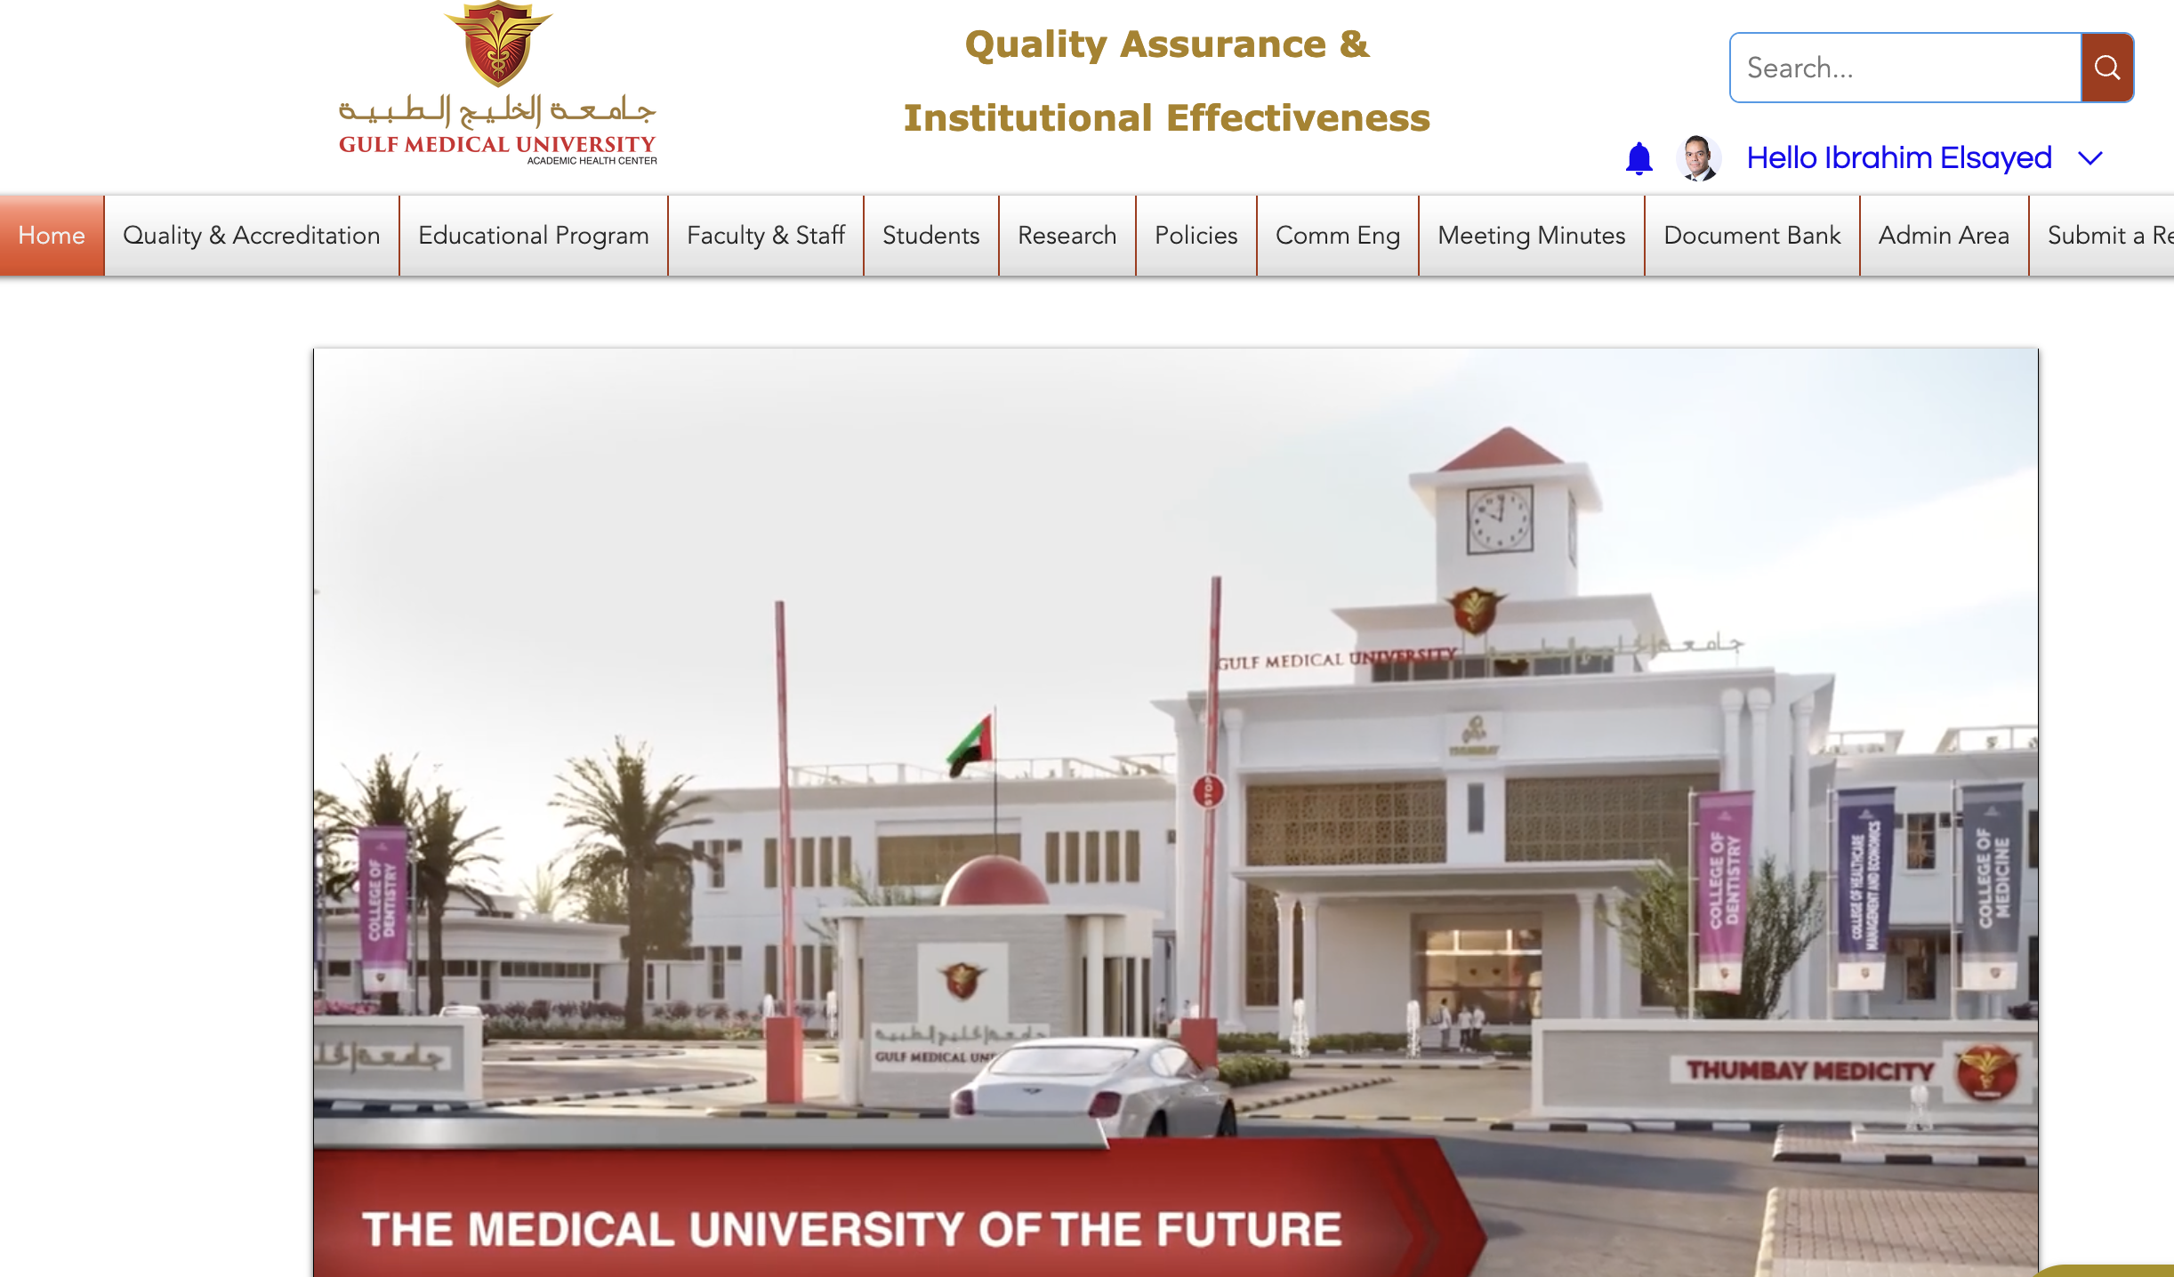
New portal
LAUNCHED on March 1, 2022

Slide 26
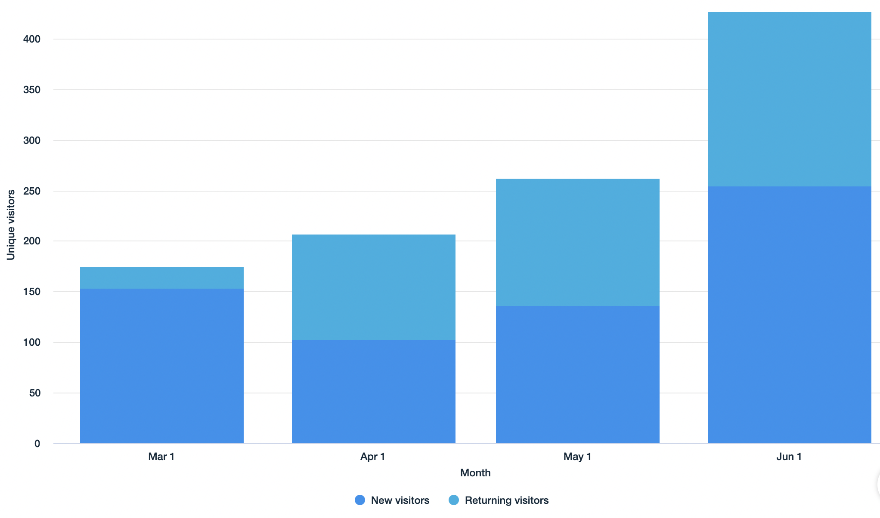
New portal
UNIQUE VISITORS PER MONTH

Slide 27
New portal
APPLICATIONS
Launched in 21/22
To be launched in 22/23
Faculty profile
Analytics of workload
Analytics of % faculty with non-terminal degree and % part-time faculty
Cohort analysis
Unofficial transcript
New meeting minutes portal
Analytics of meetings
Analytics of activities
Faculty and course databases
Course blueprint
Program blueprint
Course and faculty evaluation
Student progress (Degree Audit)
New mentorship platform
E-portfolio

Slide 28
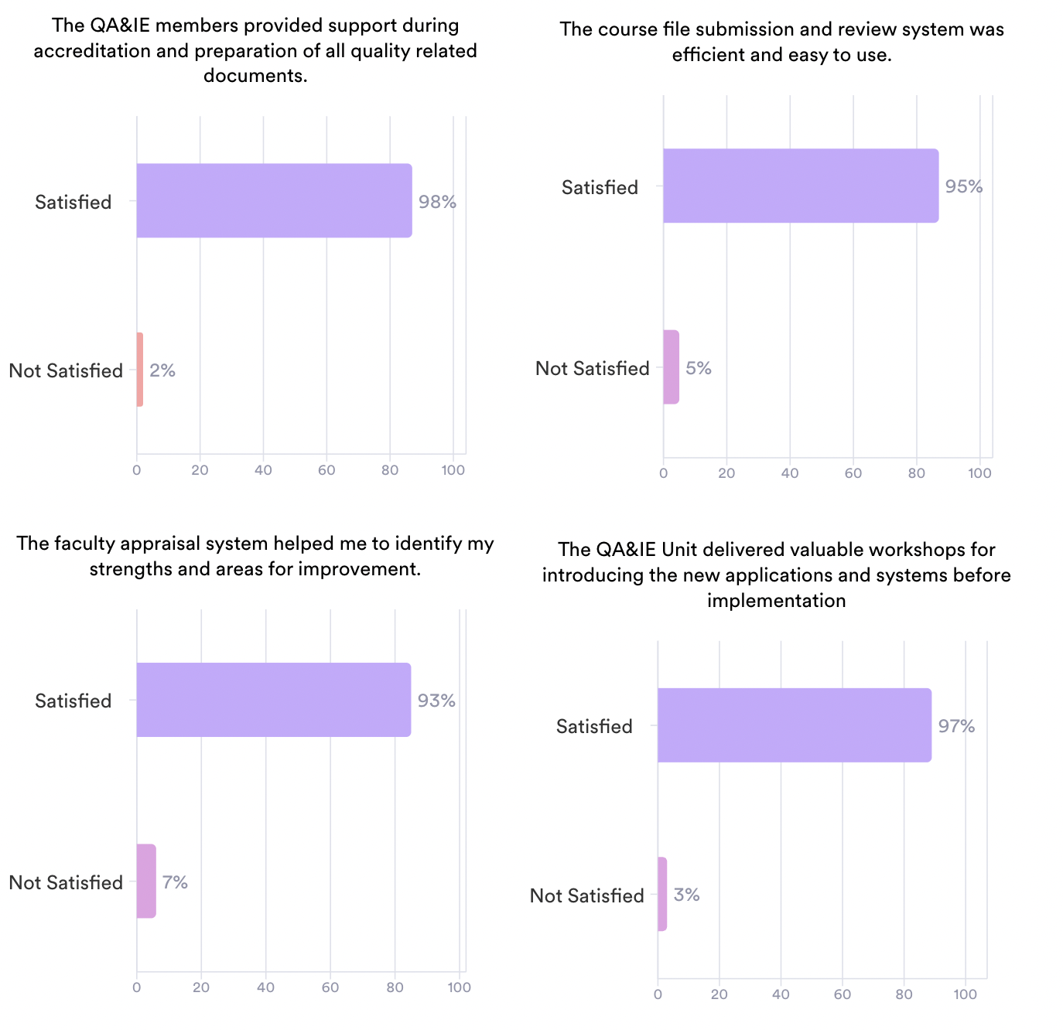
STAKHOLDER SATISFACTION OF THE QA&IE UNIT

Slide 29
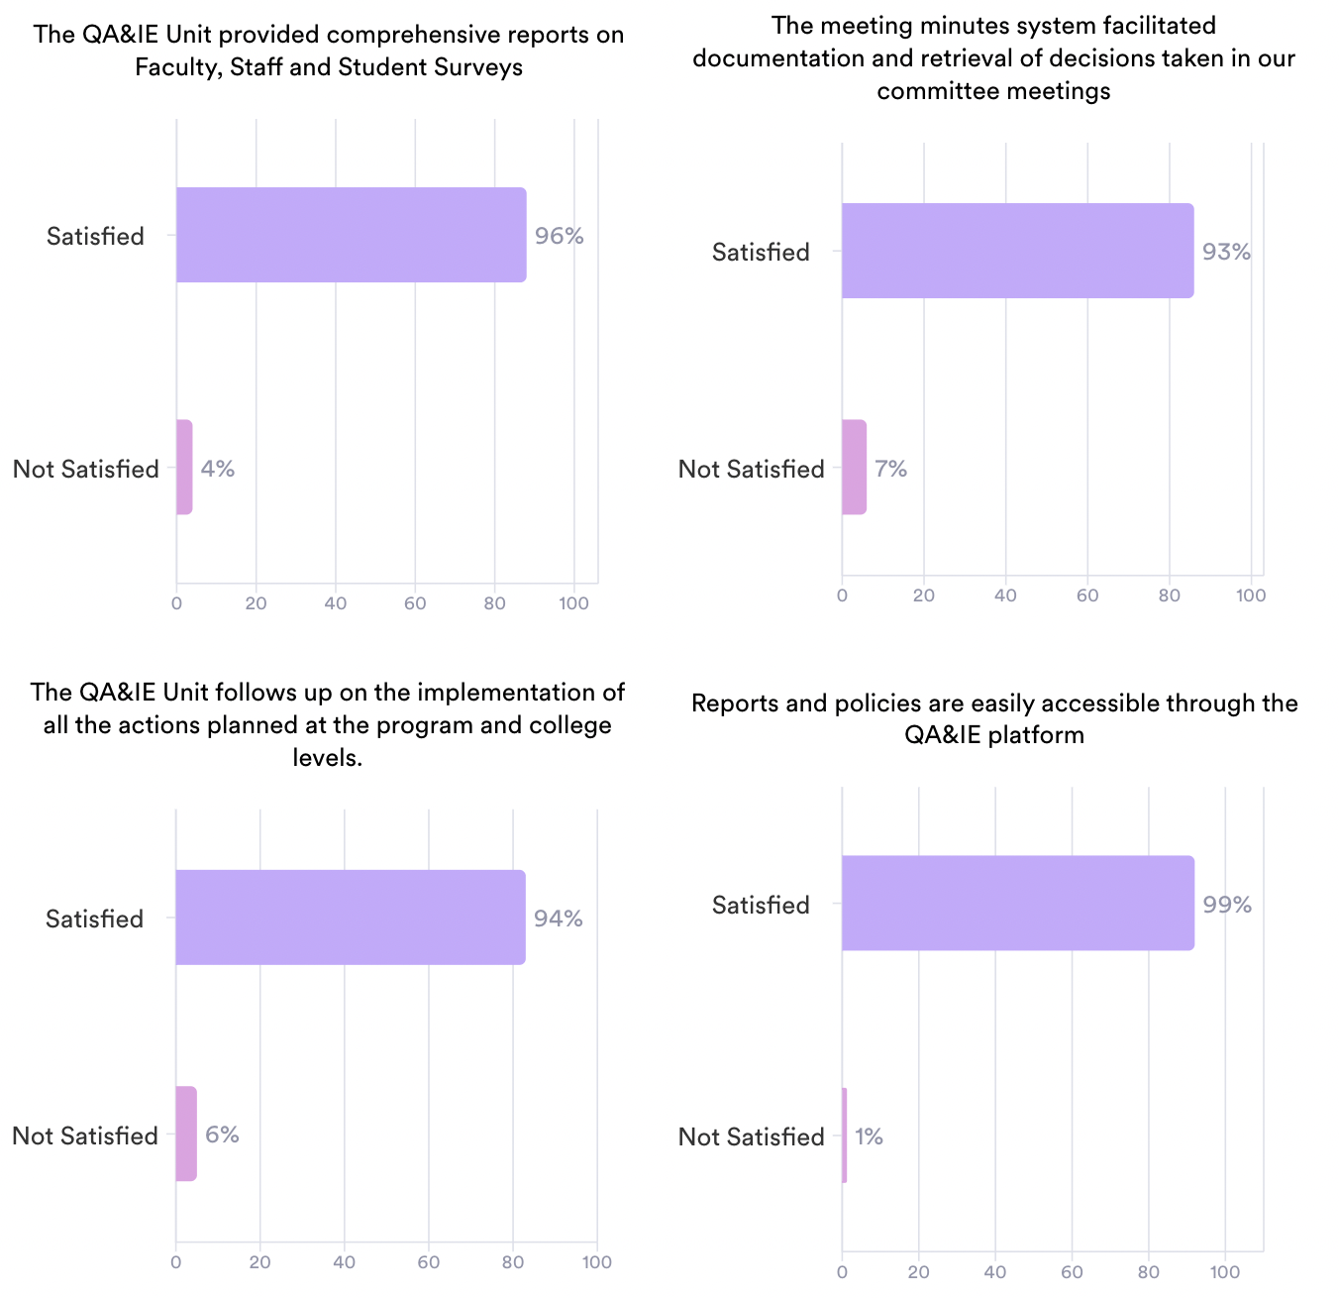
STAKHOLDER SATISFACTION OF THE QA&IE UNIT

Slide 30
STAKHOLDER SATISFACTION OF THE QA&IE UNIT
ACTION PLAN FOR 22/23
Areas for imprvement | Action taken/to be taken | Responsibility | Deadline
Survey reports take time to be published on the document bank. | Most of the reports will be available online with real-time access to all faculty. | Director – QA&IE | 1/2023
To improve the university services based on the faculty, staff and student feedback. | To develop, publish and implement action plans for improvement based on faculty, staff and student feedback on university services. | VCA with follow up by VCQGE | 12/2022
Some faculty members are mentors for more than 20 students and cannot meet them 3 times per semester as requested by the college. | To reduce the mentor-mentee official meeting to a minimum of one per semester. | College Deans with follow up by the QA&IE Unit | 12/2022

Slide 31
STAKHOLDER SATISFACTION OF THE QA&IE UNIT
ACTION PLAN FOR 22/23
Areas for imprvement | Action taken/to be taken | Responsibility | Deadline
Faculty appraisal survey are too long and exhuasting. | To inform faculty members that all the fields in the form are not compulsary. | Director – QA&IE | 1/2023
Applications are frequently changed and updated which is sometimes confusing to some faculty members. | - To make sure that changes are essential and cannot be avoided. - To have more orientation sessions and/or videos for any new application. | Director – QA&IE | Across the academic year
Achievement of practical and clinical learning outcomes are not captured. | To have a digital course blueprint that reflects all course elements consolidated. | Director – QA&IE in collaboration with program directos | 1/2023

Slide 32
STAKHOLDER SATISFACTION OF THE QA&IE UNIT
ACTION PLAN FOR 22/23
Areas for imprvement | Action taken/to be taken | Responsibility | Deadline
Deadlines are sometimes unrealistic. | Preliminart deadlines are shared with college Deans and getting their feedback before finalizing these deadline. | VCQGE | Across the academic year
Graduation report is too long and has unncessary sections | To create a template for the graduation report and share it with the program directors. | Director – QA&IE | Done (Link)
Policy changes may not widely dissemnated. | To review and operationalize the policy of policy dissementation (GMU-POL-S01-006). | Director – QA&IE | Across the academic year
Caspio report is not exportable as PDF | Already addressed. All Caspio reports now can be exported as PDF. | Director – QA&IE | Done

Slide 33


